Slide 1



Creating an AWS Account

Slide 2
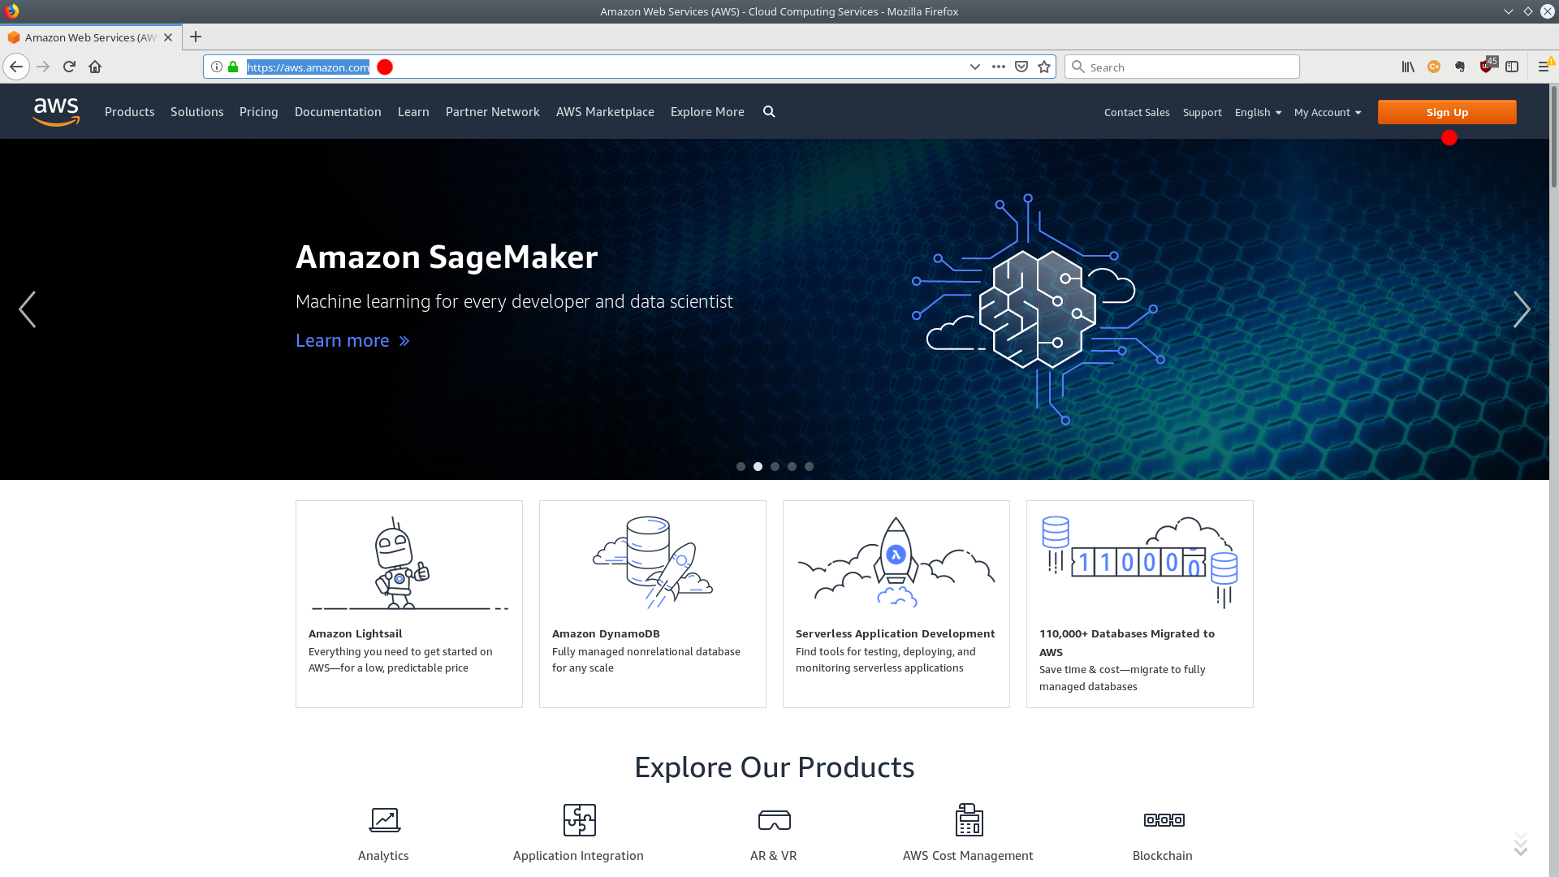
Creating an AWS Account
Open your web browser and navigate to:
https://aws.amazon.com/
Click "Sign Up"

Slide 3
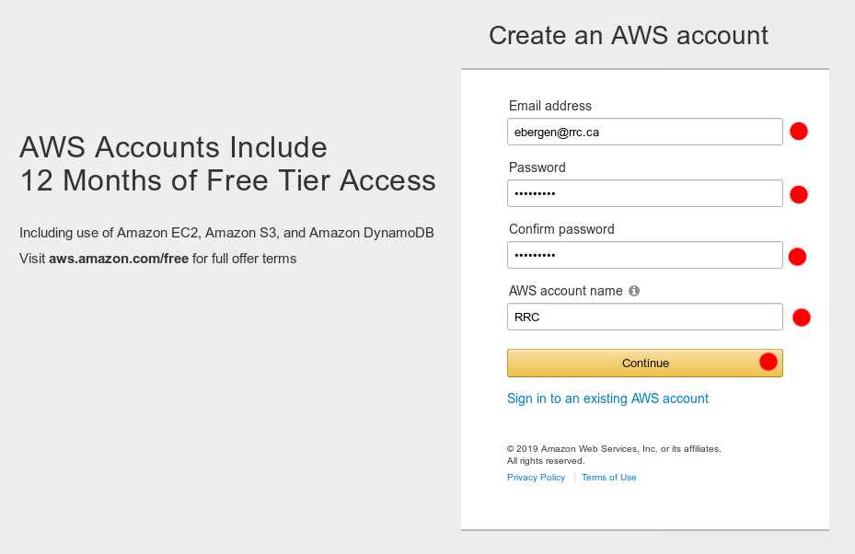
Creating an AWS Account
Fill in your information
Click "Continue"

Slide 4
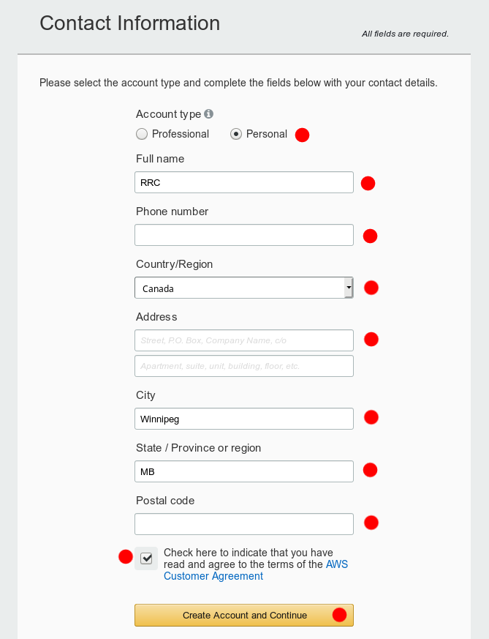
Creating an AWS Account
Select "Personal" account
Fill in your contact details
Agree to the terms
Click "Create Account and Continue"

Slide 5
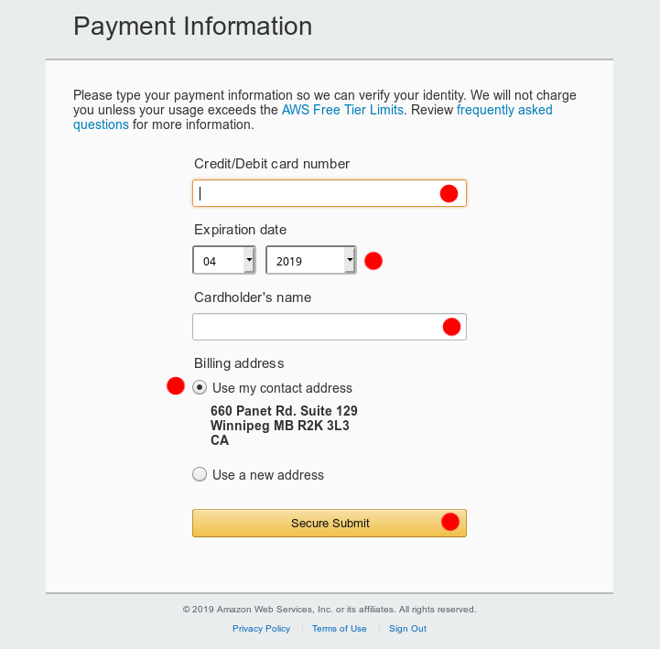
Creating an AWS Account
Enter payment information
Click "Secure Submit"
AWS will charge $1 to your credit card, then immediately reimburse it, to ensure your card is valid.
You won't be charged anything else until your free tier expires and/or you use services that cost money

Slide 6
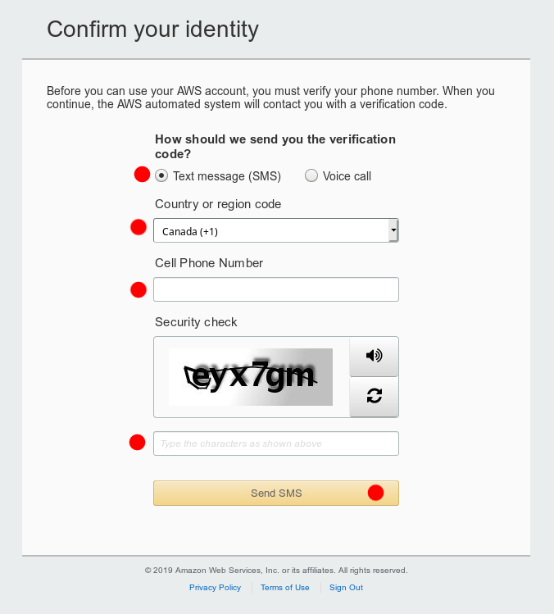
Creating an AWS Account
Fill in the info to confirm your identity
Type the Captcha characters
Click "Send SMS"

Slide 7
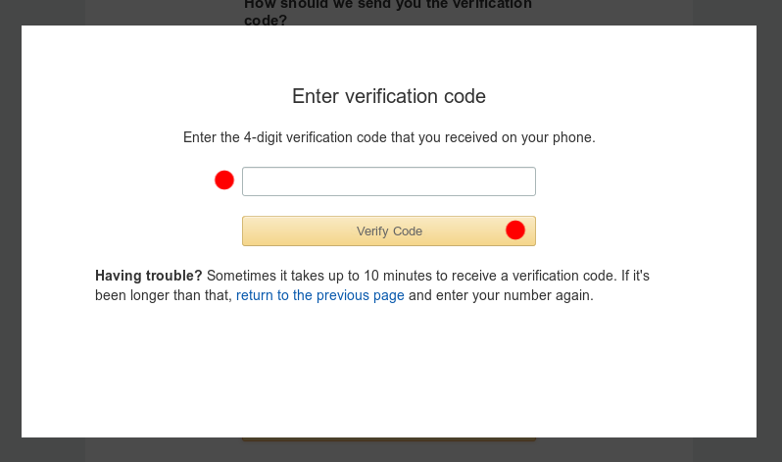
Creating an AWS Account
You should receive a code on your phone
Type in your code
Click "Verify Code"

Slide 8
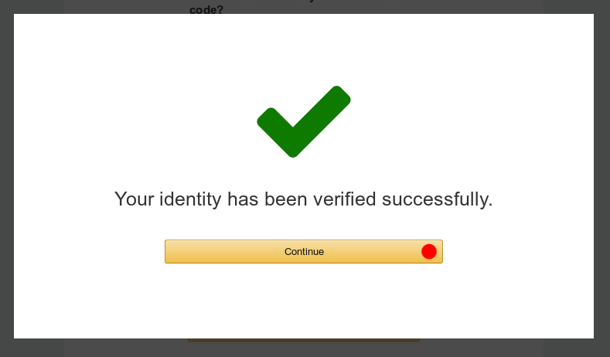
Creating an AWS Account
If everything went well, you should get the big green checkmark
Click "Continue"

Slide 9
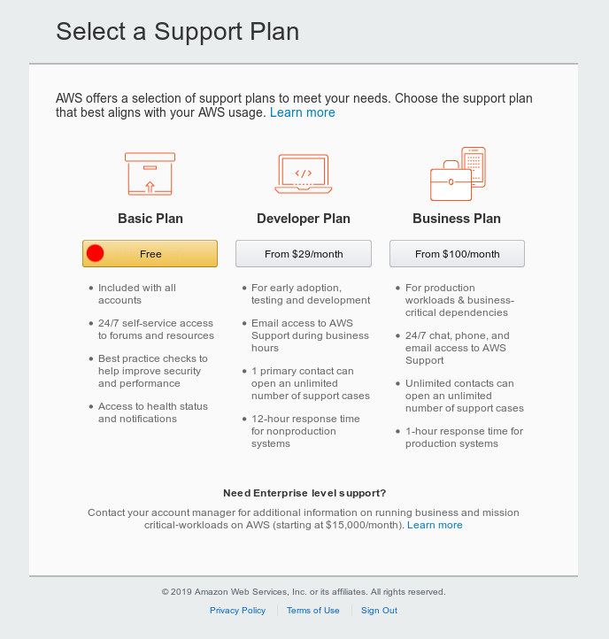
Creating an AWS Account
Choose the free "Basic Plan"

Slide 10
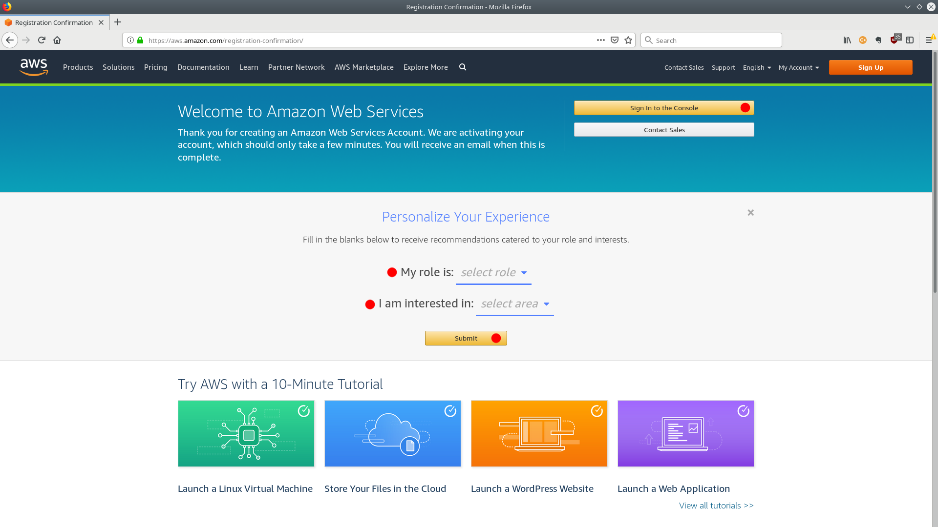
Creating an AWS Account
Select your role
Select "Internet of Things"
Click "Submit"

Slide 11
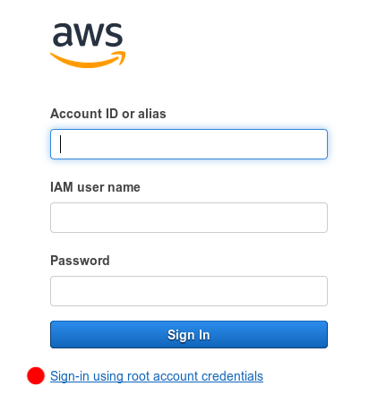
Creating an AWS Account
We'll come back to this screen later, after we've created an admin user
For now, you have to login with your root account credentials
Click "Sign-in using root account credentials"

Slide 12
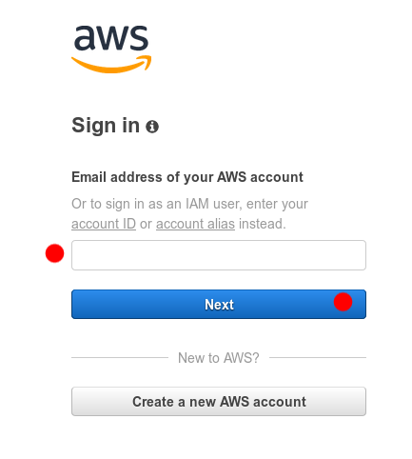
Creating an AWS account
Type in the email address and password you used to create your account

Slide 13
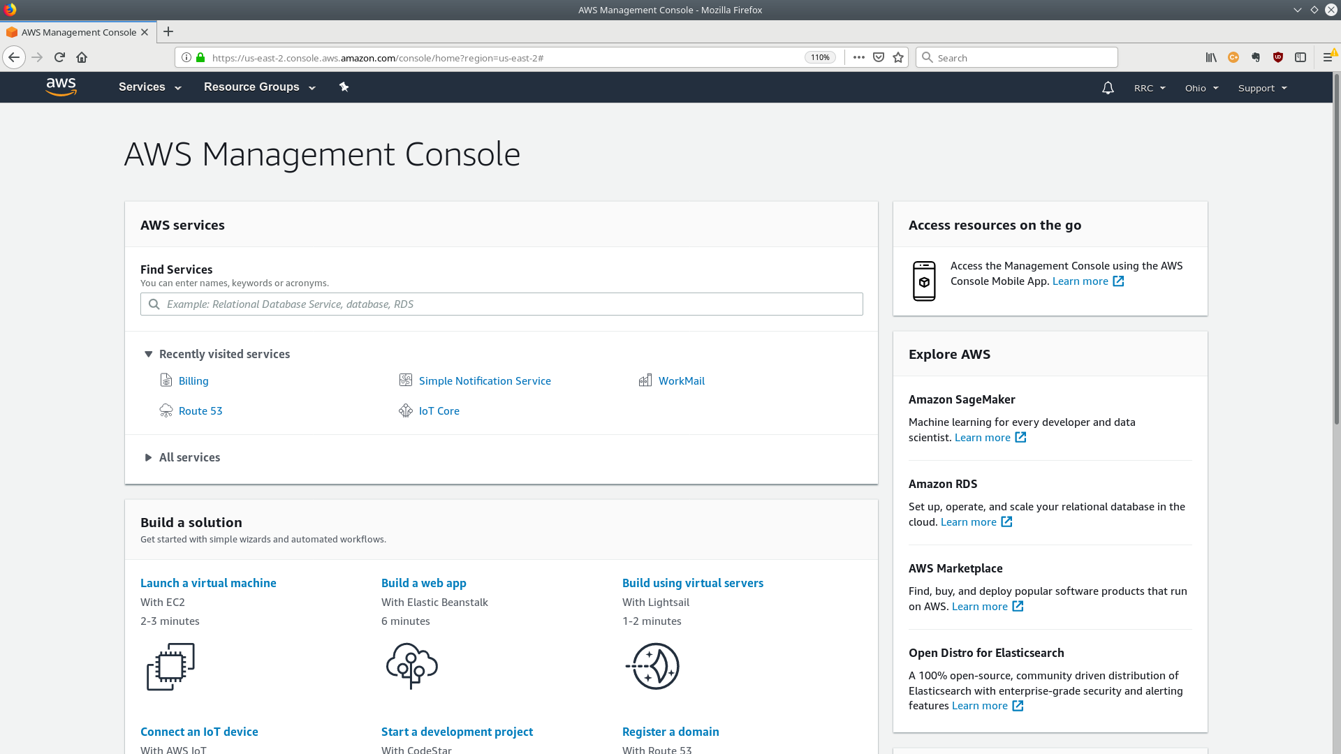
Creating an AWS Account
Welcome to the AWS Management Console
You can access all of the AWS services from here
In the next module we'll be setting up an admin user

